Slide 1
LEA Block Cipher in Rust Language: Trade-off between Memory Safety and Performance
Sangwon Kim, Siwoo Eum, Minho Song, Hwajeong Seo
Hansung University, South Korea

Slide 2
Introduction
LEA Block Cipher is a 128-bit block cipher developed in C and has such advantages
Provide confidentiality in high-speed environments
Provide efficient encryption and decryption
Reduce hardware footprint and manufacturing costs
Incorporate countermeasures against side-channel attacks
Allows for adaptation to diverse applications by flexibility, while standardization ensures interoperability and reliability.
Despite these advantages, LEA has vulnerabilities because of the nature of the C. This grants programmers memory access autonomy but is prone to errors
Dangling Pointer
Double frees
Buffer overflow
Heap metadata overwrites
Uninitialized reads

Slide 3
Memory Safety and System Security
Memory safety is crucial, especially in low-level programming, where errors can lead to significant bugs and security issues in critical code
Unsafe memory practices are among the most severe software vulnerabilities today
Microsoft identified that 70% of security flaws in Windows stem from improper memory usage
At its core, memory safety involves ensuring that software reliably manages memory allocation and access
This includes preventing bugs such as buffer overflows, dangling pointers, and other forms of memory corruption or mismanagement
The memory safety violations compromise system integrity and availability and threaten the confidentiality of sensitive data
Using Rust can be one of the strategies to ensure memory safety

Slide 4
Safe and Efficient System Programming with Rust
Rust achieves memory safety through its unique feature
Ownership Rules
Every piece of data has a single owner
Ownership can be transferred from one part of the program to another
This ownership system ensures that when the owner, such as a variable, goes out of scope, Rust automatically deallocates the associated memory, preventing memory leaks
Borrowing
Rust allows data to be borrowed via references, which must have lifetimes shorter than that of the owner.
This ensures that references cannot outlive the data they point to, thus avoiding dangling pointers
It allows either multiple immutable references or a single mutable reference at one time, but not both.
This rule ensures that data can either be read from multiple places without being altered, or it can be altered from a single place without concurrent reads, which effectively prevents data races
Borrow checker
The Rust compiler is pivotal in enforcing ownership and borrowing rules through its borrow checker.
The borrow checker analyses all references in the code to ensure compliance with borrowing rules, checking the lifetimes of variables and their uses.
It ensures that no two mutable references exist simultaneously for the same data and that references do not outlive their source.
This compile-time enforcement of ownership and borrowing rules means that common memory safety issues such as null pointer dereferencing, and buffer overflows are almost impossible in Rust.

Slide 5
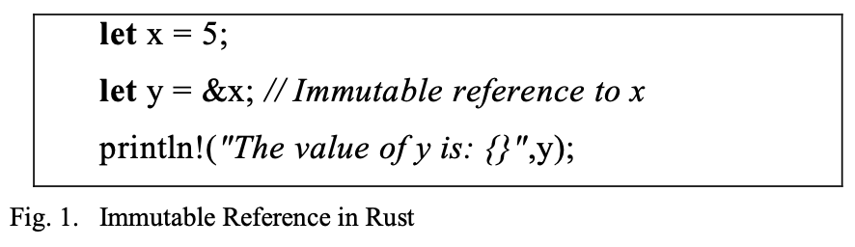
Safe and Efficient System Programming with Rust
Rust achieves memory safety through its unique feature
Immutable References
An immutable reference allows you to read data without modifying it.
Multiple immutable references to the same data can exist simultaneously, enabling safe concurrent reads.
This is possible because the data is guaranteed not to change while these references are active, preventing data races and ensuring consistency.

Slide 6
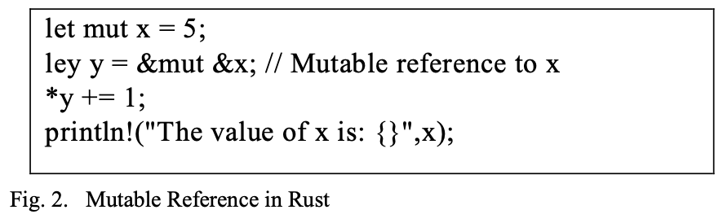
Safe and Efficient System Programming with Rust
Rust achieves memory safety through its unique feature
Mutable References
A mutable reference allows you to both read and modify data.
However, to maintain safety, Rust only permits one mutable reference to a particular piece of data at a time.
This exclusivity ensures that no other references can access the data concurrently, thereby avoiding race conditions and ensuring that the data cannot be altered unexpectedly while it is being read or written to.

Slide 7
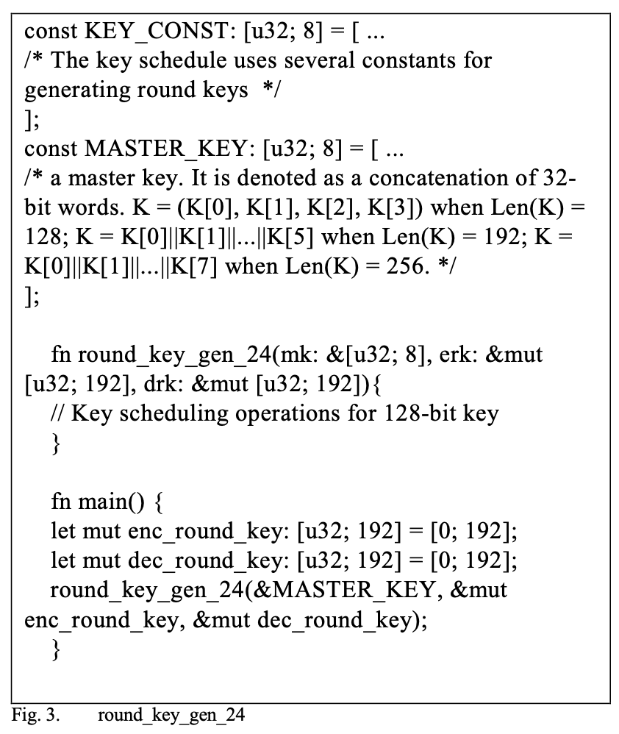
Comparative Analysis of LEA Key Scheduling in C and Rust
LEA Key Scheduling in Rust
Key point
Data Races
By allowing only one mutable reference or multiple immutable references at any point in time, Rust ensures that data races are prevented
Borrow Checker
Rust’s compiler includes a borrow checker that enforces memory safety rules at compile time
This borrow checker ensures that references do not outlive the data they refer to, preventing the creation of dangling references
This mechanism prevents any unsafe access to these references outside their intended lifetime, maintaining memory safety and data integrity
Function Signature
The function signature itself is designed to ensure memory safety.
By requiring the keys as references rather than taking ownership, the function avoids unnecessary data copying, which not only saves on performance but also reduces the complexity of memory management

Slide 8
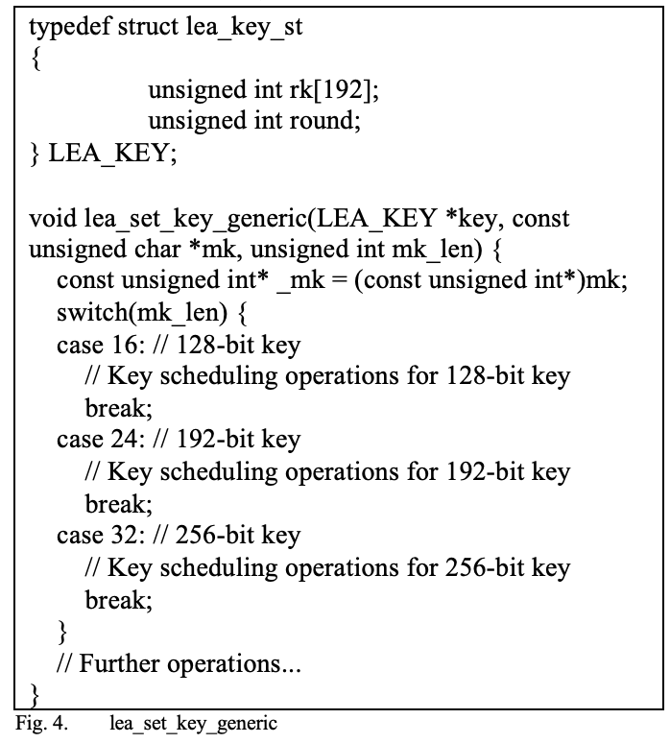
Comparative Analysis of LEA Key Scheduling in C and Rust
LEA Key Scheduling in C
The problems that can arise from C code
Memory Alignment
Data of type unsigned int must be aligned to 4-byte boundaries
However, data of type unsigned char* can be accessed in byte units and may not be aligned to 4-byte boundaries
If mk is not aligned to a 4-byte boundary, casting it to const unsigned int* and accessing it may result in undefined behavior
Memory Access Errors
If the alignment is incorrect when accessing data in 4-byte units, the CPU may raise an exception due to unaligned memory access
This is particularly problematic on some architectures

Slide 9
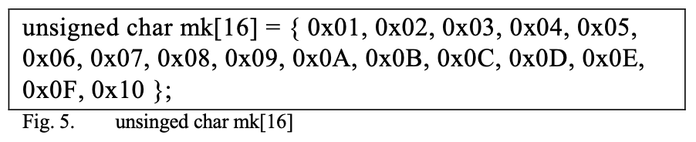
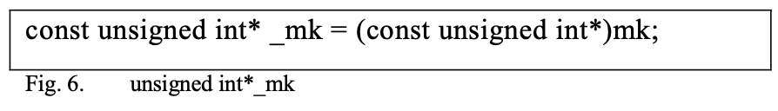

Comparative Analysis of LEA Key Scheduling in C and Rust
For example, consider the following byte array for mk:
Casting this array to unsigned int* and accessing it would be interpreted as follows:
Here, _mk[0] would be 0x04030201 and _mk[1] would be 0x08070605. However, if mk is not aligned to a 4-byte boundary, for example:
In this case, mk is not aligned to a 4-byte boundary.
The `+1` moves the pointer by one byte, making it unaligned. Casting this to unsigned int* and accessing it may result in undefined behavior because the address is not a multiple of 4.
In C, great care must be taken when accessing memory through pointer type casting.
Particularly, when casting a byte-pointer to a 4-byte pointer, memory alignment issues must be considered. Languages like Rust enforce memory safety to prevent such issues.
In Rust, the compiler warns or errors out on such casts, helping the programmer to write safe code.

Slide 10
Benchmark
Jemalloc
Memory allocation library designed to manage memory efficiently, especially in multithreaded environments
Provides comprehensive statistics for optimizing and understanding memory usage
Offer insights into several critical aspects of memory management, enabling performance tuning, leak detection, and capacity planning
Interpretation of Jemalloc Statistics
Allocated
Total memory allocated by the program from the system, indicating the application’s memory demand during execution.
Active
Active memory is the amount of allocated memory still in use by the application, including fragmented memory and overhead that remains within allocated blocks.
Metadata
Metadata is the memory used by Jemalloc to manage allocation and deallocation, including data structures and tables, adding overhead to total memory usage.
Resident
Resident memory is the portion of a process’s memory currently in RAM, indicating the application’s actual physical memory usage.
Mapped
Mapped memory is the total virtual address space allocated by Jemalloc, including both used and unused regions, indicating the memory resources reserved for the application and impacting overall system memory availability.
Environment for measuring specifications
Model : MacBook Air
Chip : Apple M2 (2022)
Memory : 8 GB
Operating System : macOS Sonoma 14.5
 | Allocated | Active | Metadata | Resident | Mapped
C | 174,720 | 376,832 | 2,616,832 | 2,899,968 | 6,668,288
Rust | 4,227,960 | 5,750,784 | 2,645,632 | 8,372,224 | 12,124,160
JEMALLOC STATISTICS

Slide 11
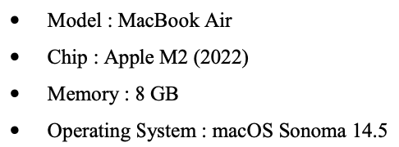

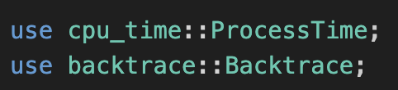
Benchmark
JEMALLOC STATISTICS
Interpretation of Jemalloc Statistics
Allocated
Total memory allocated by the program from the system, indicating the application’s memory demand during execution.
Active
Active memory is the amount of allocated memory still in use by the application, including fragmented memory and overhead that remains within allocated blocks.
Metadata
Metadata is the memory used by Jemalloc to manage allocation and deallocation, including data structures and tables, adding overhead to total memory usage.
Resident
Resident memory is the portion of a process’s memory currently in RAM, indicating the application’s actual physical memory usage.
Mapped
Mapped memory is the total virtual address space allocated by Jemalloc, including both used and unused regions, indicating the memory resources reserved for the application and impacting overall system memory availability.
 | Allocated | Active | Metadata | Resident | Mapped
C | 174,720 | 376,832 | 2,616,832 | 2,899,968 | 6,668,288
Rust | 4,227,960 | 5,750,784 | 2,645,632 | 8,372,224 | 12,124,160
LEA CPU Time in C
Key Size (bits) | Key Schedule (ms) | Encryption (ms) | Decryption (ms)
128 | 3.675 | 2.132 | 1.853
192 | 6.348 | 2.111 | 1.813
256 | 6.573 | 2.139 | 1.815
LEA CPU Time in Rust
Key Size (bits) | Key Schedule (ms) | Encryption (ms) | Decryption (ms)
128 | 12.907 | 21.632 | 21.947
192 | 17.354 | 21.715 | 23.409
256 | 30.104 | 22.342 | 23.632

Slide 12
Benchmark
CPU time measurement in C
C Standard Library (<time.h>)
LEA CPU Time in C
Key Size (bits) | Key Schedule (ms) | Encryption (ms) | Decryption (ms)
128 | 3.675 | 2.132 | 1.853
192 | 6.348 | 2.111 | 1.813
256 | 6.573 | 2.139 | 1.815
CPU time measurement in Rust
C Standard Library (<time.h>)
LEA CPU Time in Rust
Key Size (bits) | Key Schedule (ms) | Encryption (ms) | Decryption (ms)
128 | 12.907 | 21.632 | 21.947
192 | 17.354 | 21.715 | 23.409
256 | 30.104 | 22.342 | 23.632

Slide 13
Conclusion
This study implemented the LEA block cipher in Rust, highlighting the potential safety advantages over traditional C implementations
Using Rust could enhance memory safety due to its strict ownership and borrowing principles, which prevent common vulnerabilities
However, performance measurements using jemalloc and CPU time assessment indicated that Rust’s implementation incurs a performance overhead compared to C.
Rust’s memory safety features, including bounds checking and borrow checking, introduce additional computational overhead, resulting in slower key generation and encryption/decryption processes.
Despite these performance trade-offs, the enhanced security provided by Rust makes it a viable option for cryptographic applications where safety is paramount.

Slide 14
Benchmark
Jemalloc
memory allocation library designed to manage memory efficiently, especially in multithreaded environments.
One of the primary advantages of jemalloc is its ability to significantly reduce memory fragmentation, ensuring more contiguous memory allocations and deallocations.
This is crucial for environments requiring high concurrency.
Traditional memory allocators can become bottlenecks due to lock contention when threads access memory resources simultaneously.
jemalloc mitigates this by employing a multi-arena allocation system[9], reducing contention and improving overall performance.
Another significant feature of jemalloc is its configurability, allowing developers to tune various parameters for optimal performance in different scenarios, whether for high-load servers or memory-intensive computations.
jemalloc also offers robust tools for monitoring and analyzing memory usage, aiding in performance tuning and leak detection.
The adoption of jemalloc in popular databases like MongoDB and Redis, as well as in programming languages such as Rust, underscores its effectiveness.
These systems benefit from jemalloc by handling large numbers of simultaneous connections or operations more efficiently than traditional memory allocators.

Slide 15
Benchmark
Intepretation of Jemalloc Statistics
Allocated
the total memory allocated by the program from the system, indicating the application’s memory demand during execution.
Active
Active memory is the amount of allocated memory still in use by the application, including fragmented memory and overhead that remains within allocated blocks.
Metadata
Metadata is the memory used by Jemalloc to manage allocation and deallocation, including data structures and tables, adding overhead to total memory usage.
Resident
Resident memory is the portion of a process’s memory currently in RAM, indicating the application’s actual physical memory usage.
Mapped
Mapped memory is the total virtual address space allocated by Jemalloc, including both used and unused regions, indicating the memory resources reserved for the application and impacting overall system memory availability.
 | Allocated | Active | Metadata | Resident | Mapped
C | 174,720 | 376,832 | 2,616,832 | 2,899,968 | 6,668,288
Rust | 4,227,960 | 5,750,784 | 2,645,632 | 8,372,224 | 12,124,160
JEMALLOC STATISTICS

Slide 16
Benchmark
Intepretation of Jemalloc Statistics
Allocated
the total memory allocated by the program from the system, indicating the application’s memory demand during execution.
Active
Active memory is the amount of allocated memory still in use by the application, including fragmented memory and overhead that remains within allocated blocks.
Metadata
Metadata is the memory used by Jemalloc to manage allocation and deallocation, including data structures and tables, adding overhead to total memory usage.
Resident
Resident memory is the portion of a process’s memory currently in RAM, indicating the application’s actual physical memory usage.
Mapped
Mapped memory is the total virtual address space allocated by Jemalloc, including both used and unused regions, indicating the memory resources reserved for the application and impacting overall system memory availability.
 | Allocated | Active | Metadata | Resident | Mapped
C | 174,720 | 376,832 | 2,616,832 | 2,899,968 | 6,668,288
Rust | 4,227,960 | 5,750,784 | 2,645,632 | 8,372,224 | 12,124,160
JEMALLOC STATISTICS

